Slide 1

State Farm Carousel

Slide 2
Problem
State Farm offers a wide range of different insurance plans that many people don’t know about
Figuring out what plan is right for you can be a challenge

Slide 3
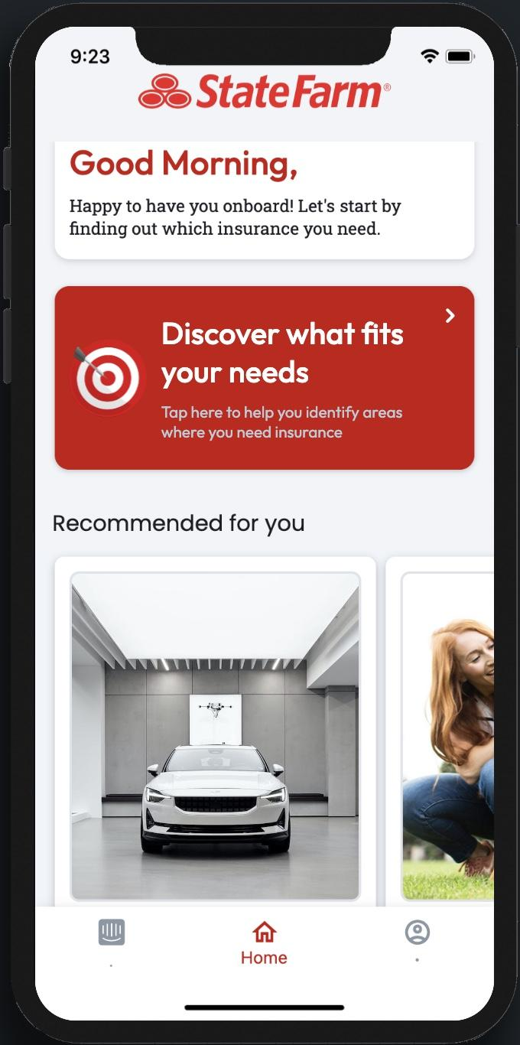
Our Solution
We developed an application that will give personalized recommendations on what plan is right for you
The application also allows the user to learn more about each insurance plan, and connect with a local agent

Slide 4
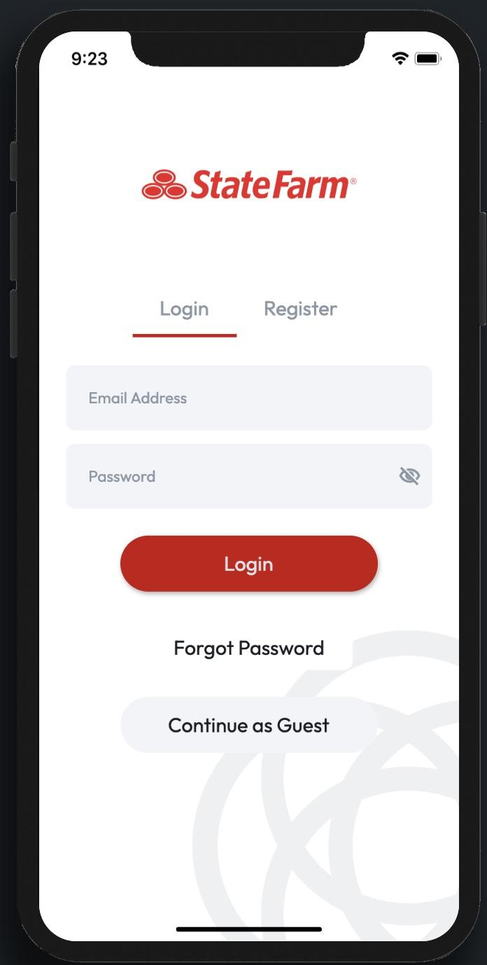
Login

Slide 5
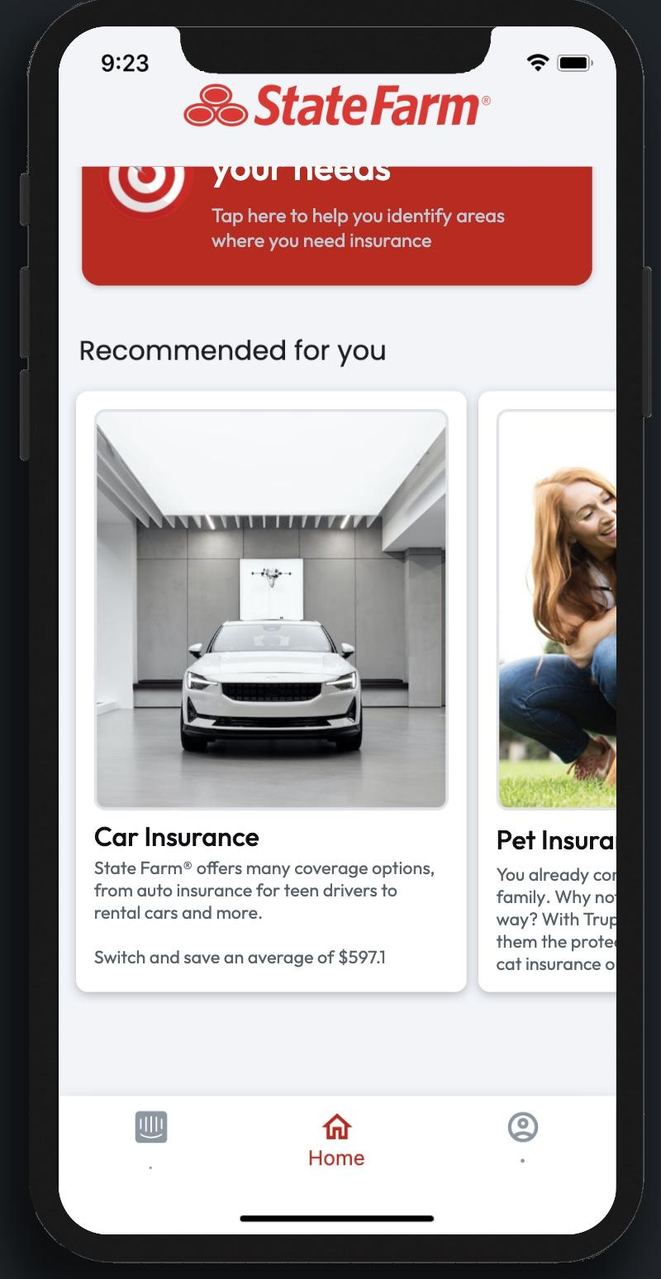
Personalized Recommendations

Slide 6
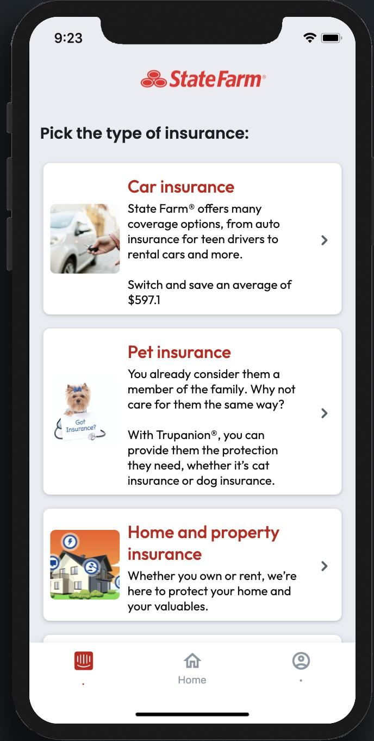
More Insurance Options

Slide 7
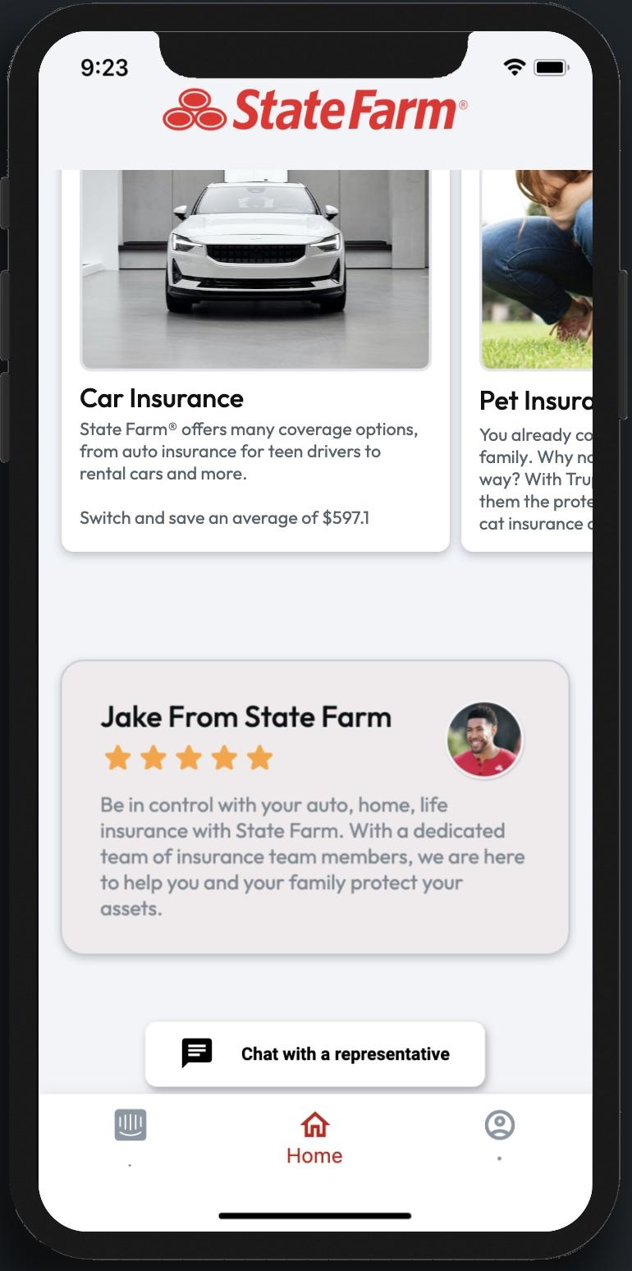
Contact Local Agent

Slide 8




Tools Used

